Slide 1
Chongqing University of Technology
ATAI
Advanced Technique of Artificial Intelligence
Chongqing Unive
A Discourse-Aware Graph Neural Network for Emotion Recognition in Multi-Party Conversation
Yunhe Xie∗, Kailai Yang∗, Chengjie Sun†, Bingquan Liu, Zhenzhou Ji
Faculty of Computing, Harbin Institute of Technology, China
{xieyh, sunchengjie, liubq, jizhenzhou}@hit.edu.cn
klyang990203@gmail.com
2021.12.28 • ChongQing
(EMNLP-2021)
Reported by Sijin Liu

Slide 2
Chongqing University of Technology
ATAI
Advanced Technique of Artificial Intelligence
Chongqing University of Technology
1. Introduction
2. Method
3. Experiments

Slide 3
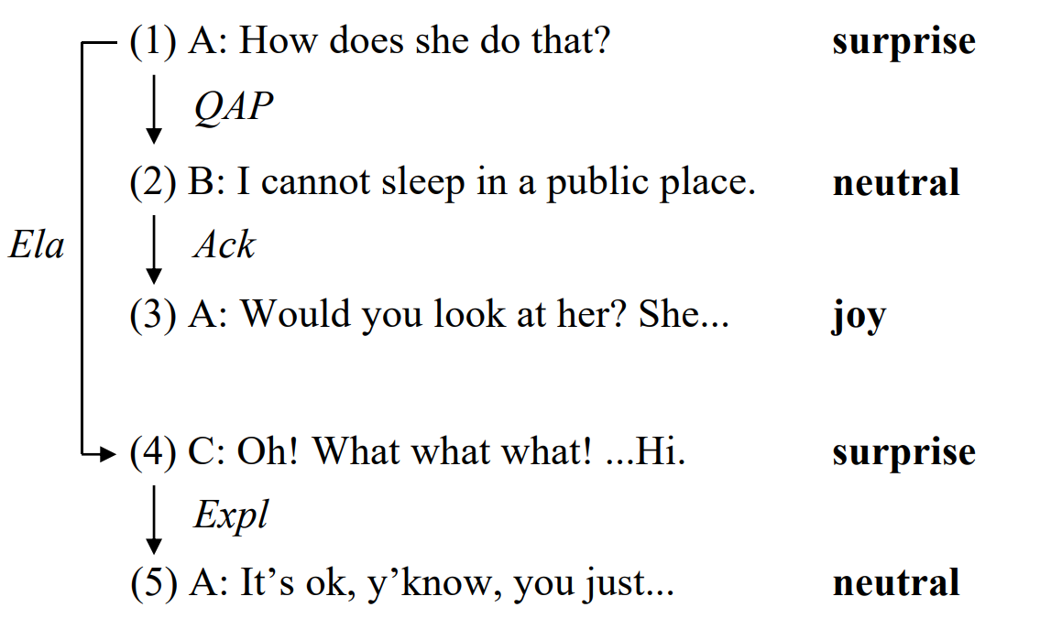
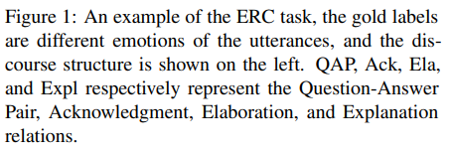
Introduction
The past work can only leverage cues in neighboring context of conversations, and are difficult to handle informative distant dependencies for ERC.

Slide 4
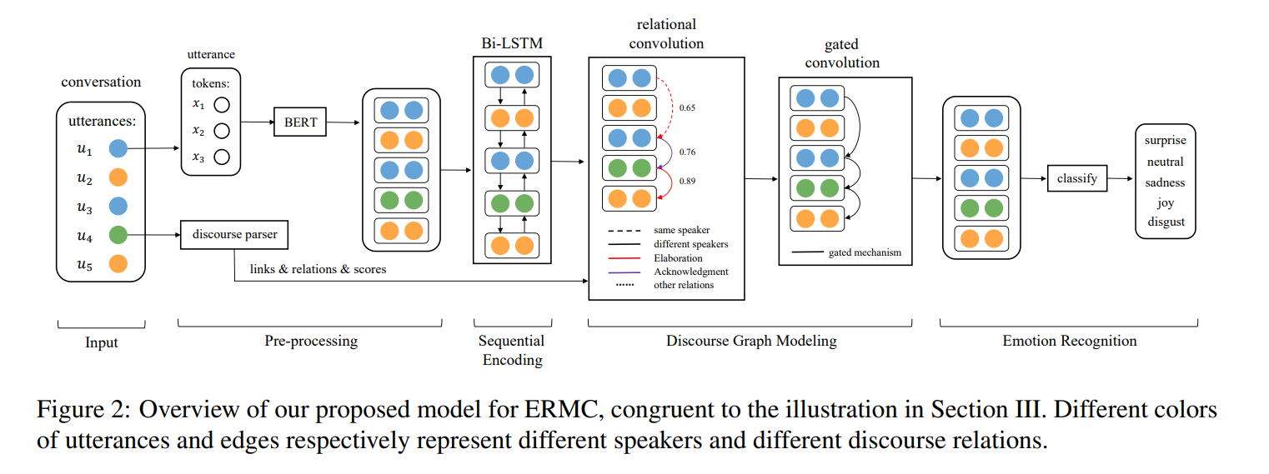
Approach

Slide 5
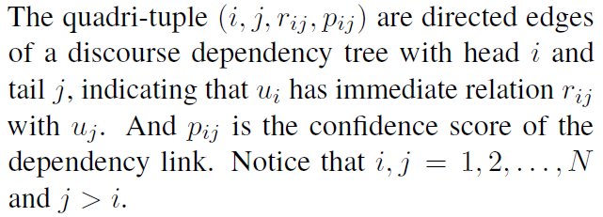
Approach
Discourse Parsing
Sequential Context Encoding

Slide 6
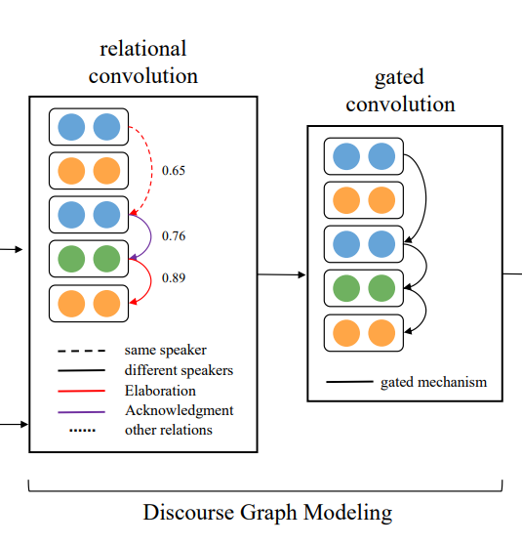
Approach
Discourse Graph Modeling
Edge Weights：
Feature Transformation：

Slide 7
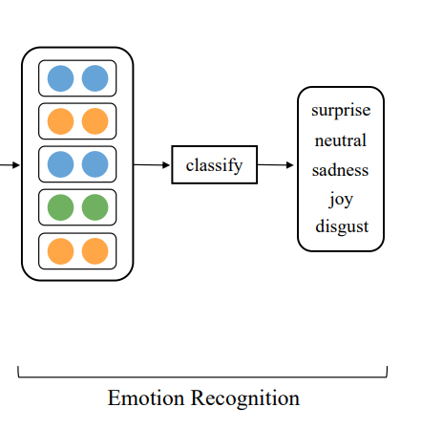
Approach
Emotion Recognition

Slide 8
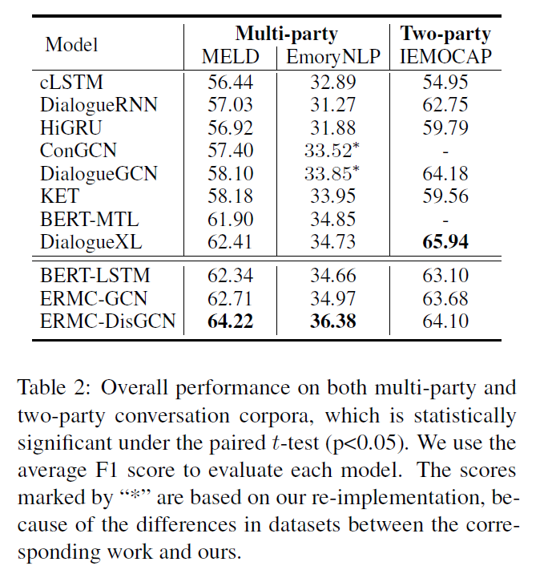
Experiments

Slide 9
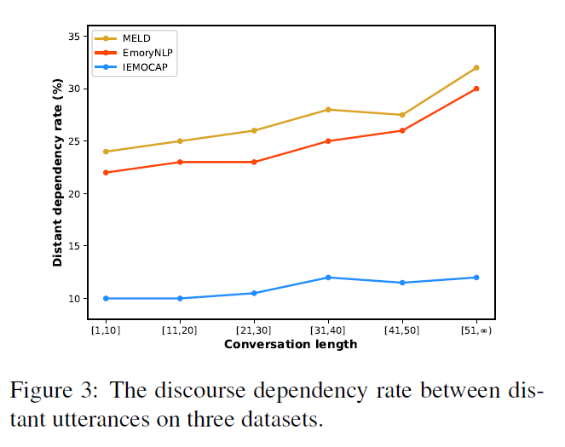
Experiments

Slide 10
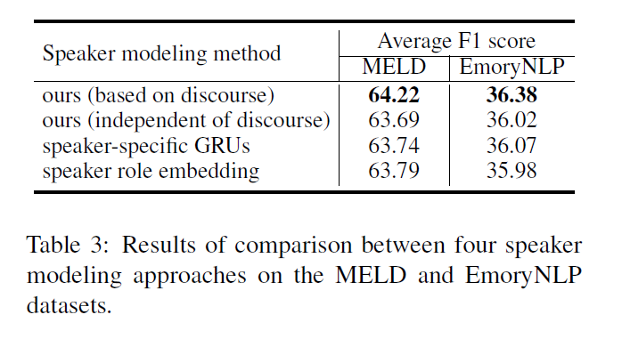
Experiments

Slide 11
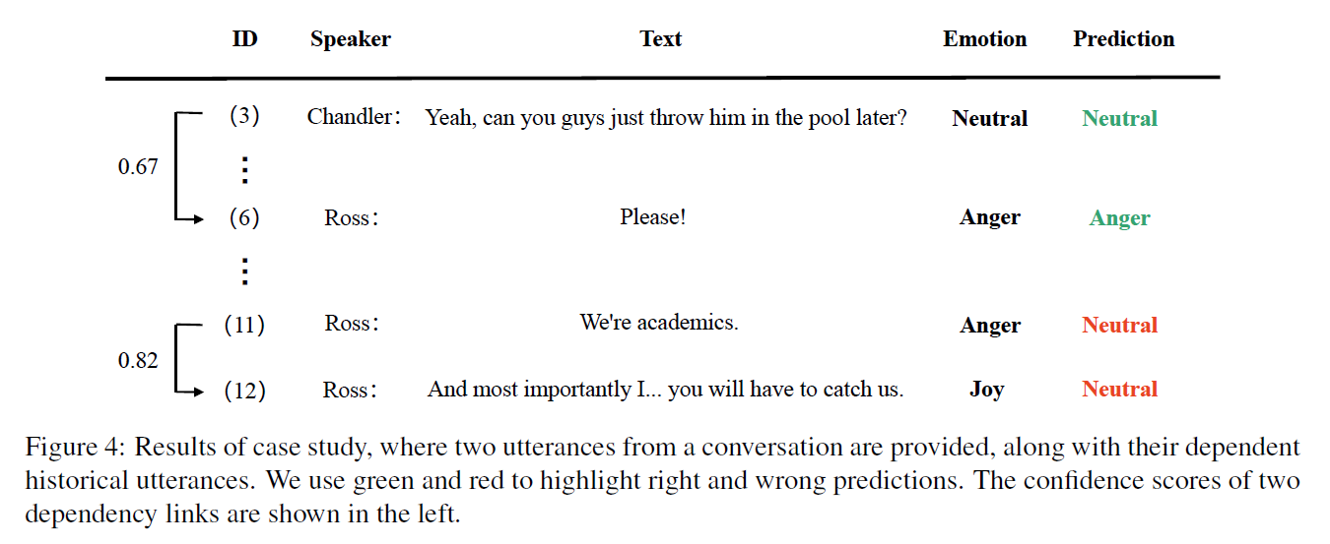
Experiments

Slide 12
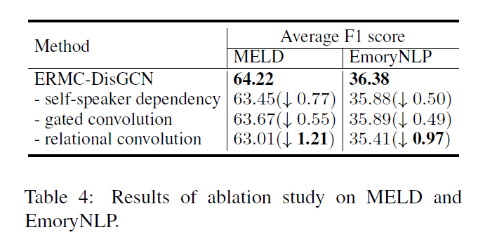
Experiments

Slide 13
Thanks

